Slide 1


Applying Statistical Learning to NBA Salaries
By: Jeffrey Ochavillo

Slide 2
BACKGROUND
OUTLINE FOR TALK
Purpose for this project
Statistical Learning
Simple Linear and Multiple Linear Regressions
Proof
PROCESS
Data wrangling and cleaning
Building multiple linear models
VISUALIZATION & INTERPRETATION
Purpose of the models and what it tells about the player and salary
Visual code and demo of code
CONCLUSION
Results and takeaways from the project and research
Moving forward

Slide 3
BACKGROUND

Slide 4
The idea came from working with Dr. Sloughter in the summer of 2018 with Data Analysis research with KiloWatts for Humanity
Introduction to Statistical Machine Learning was introduced in Fall Quarter 2018
Found a big interest in working with big data sets
Building off my interests: sports and math
Salaries in the NBA have always been a topic of discussion in sports and I want to address them
Background

Slide 5

Background on NBA Salaries
At the moment, basketball is the world’s highest paid sport. As well as earning millions per year in salary, the National Basketball Association’s best players earn a huge amount of money outside the court.
The National Basketball Association is a collection of thirty professional basketball teams in the United States and Canada. It is currently the third largest professional sports league in North America with approximately $5 billion dollars in revenue.
Also, the National Basketball Association distributes a significant amount of salary to its players, which adds to the intrigue of the game.

Slide 6




Background on Salaries of NBA
Lebron James
Steph Curry
Kevin Durant
PF/SF
SG/PG
SF/PF/SG
Total earnings: $85.5 million
Salary/bonuses: $33.5 million
Endorsements: $52 million
Total earnings: $76.9 million
Salary/bonuses: $34.9 million
Endorsements: $42 million
Total Earnings: $65 million
Salary/bonuses: $30 million
Endorsements: $35 million

Slide 7
Statistical Learning

Slide 8
General Idea of Statistical Learning
General
Suppose that we observe a quantitative response Y and p different predictors, X1, X2, . . . , Xp. We assume that there is some relationship between Y and X = (X1,X2,...,Xp), which can be written in the very general form
Y =f(X)+ε.
Here f is some fixed but unknown function of X1, . . . , Xp, and ε is a random error term, which is independent of X and has mean zero. In this formulation, f represents the systematic information that X provides about Y.
Overall
In essence, statistical learning refers to a set of approaches for estimating f. But the book I used outlined some of the key theoretical concepts that arise in estimating f, as well as tools for evaluating the estimates obtained.

Slide 9
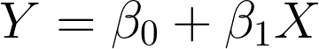
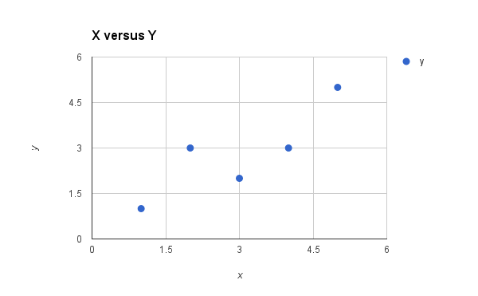
Simple Linear Regressions
Simple linear regression lives up to its name: it is a very straightforward approach for predicting a quantitative response Y on the basis of a single predictor variable X. It assumes that there is approximately a linear relationship between X and Y. Mathematically, we can write this linear relationship as
β0 and β1 are two unknown constants that represent the intercept and slope terms in the linear model. Together, β0 and β1 are known as the model coefficients or parameters.

Slide 10
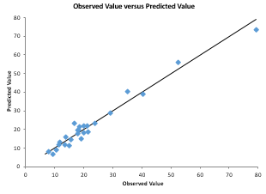
Simple linear regression is a useful approach for predicting a response on the basis of a single predictor variable.
Multiple Linear Regressions
Instead of fitting a separate simple linear regression model for each predictor, a better approach is to extend the simple linear regression model so that it can directly accommodate multiple predictors. We can do this by giving each predictor a separate slope coefficient in a single model. In general, suppose that we have p distinct predictors. Then the multiple linear regression model takes the form
Here X_{j} represents the jth predictor and βj quantifies the association between that variable and the response. We interpret β_{j} as the average effect on Y of a one unit increase in X_{j} , holding all other predictors fixed.

Slide 11
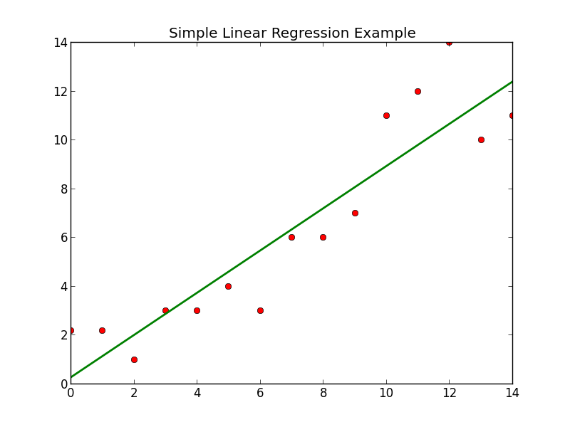

Slide 12
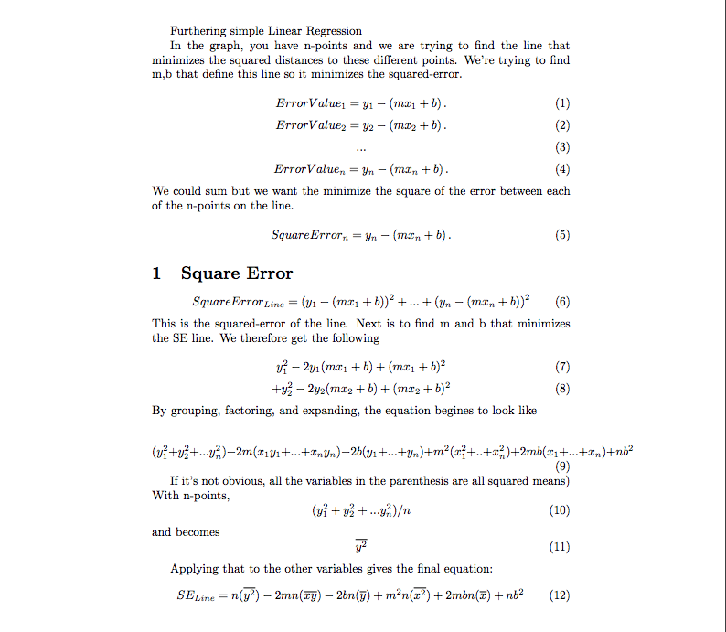

Slide 13
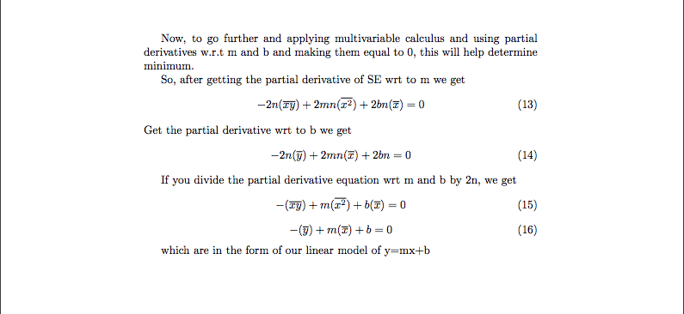

Slide 14
Process

Slide 15
Need to find data for players with theirs stats and salaries.
Process
I had to work with two sets of data. One being the data that record every players’ stats from the 2018-2019 season. Other showing salaries.
Used RStudio to make plots and diagrams to help find linear correlations with salary.
Log-transformed the value of salaries to provide a more readable graph.
Overall, just a lot of coding in RStudio

Slide 16
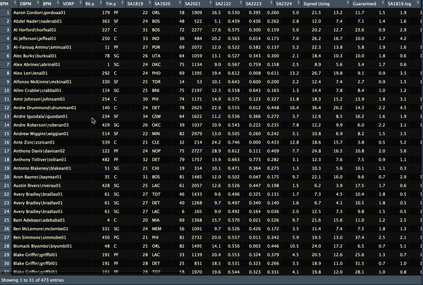
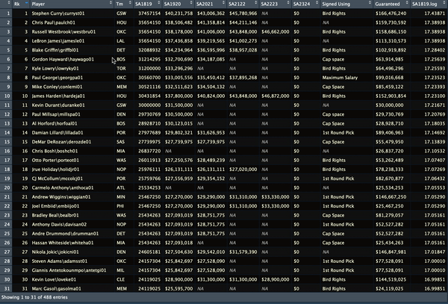
Data for Stats
Data for Salary
473 listed players in the NBA
Stats recorded:
MP, PER, TS%, FTr,
3PAR, ORB%, DRB%, TRB%, AST%
STL%, BLK%, TOV%, USG%, OWS%,
DWS%, WS, WS/48, OBPM, DBPM,
BPM, Value over Replacement Player
Salaries for season 2018 until season 2022

Slide 17
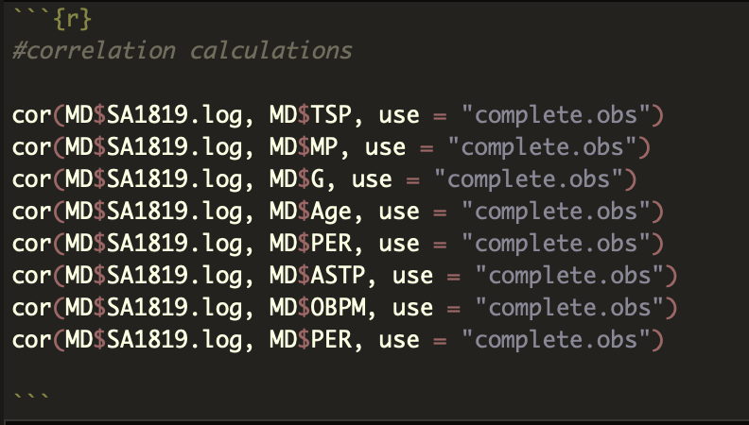
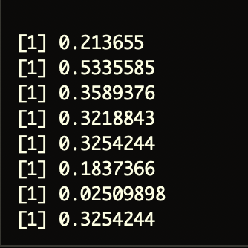
Correlation Functions
R function cor() can be used to find correlation matrix. It computes the correlation coefficient.
Notes:
http://www.sthda.com/english/wiki/correlation-test-between-two-variables-in-r#what-is-correlation-test

Slide 18
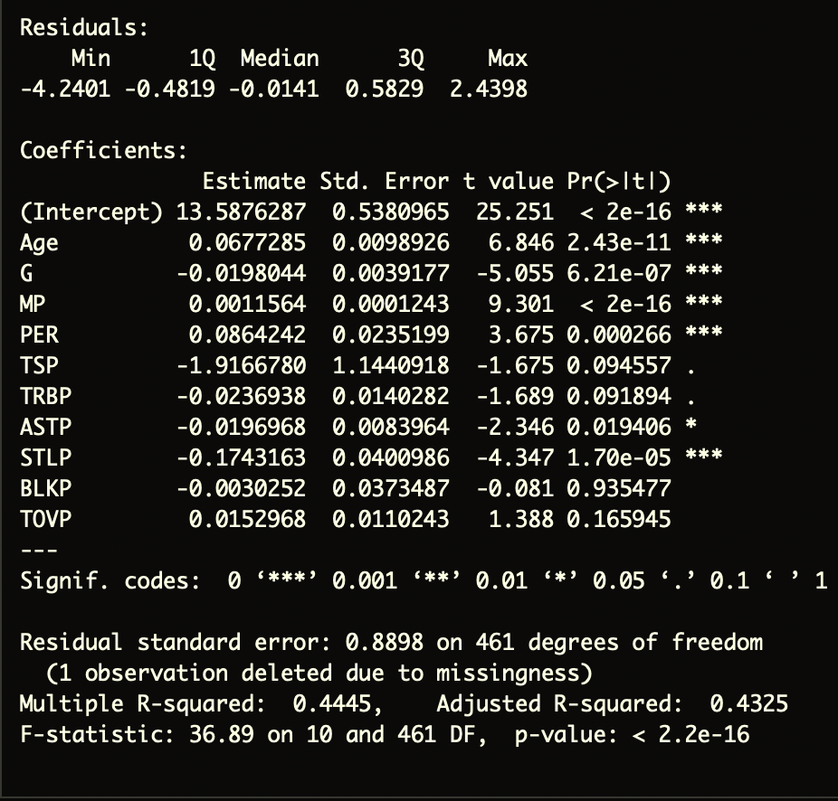
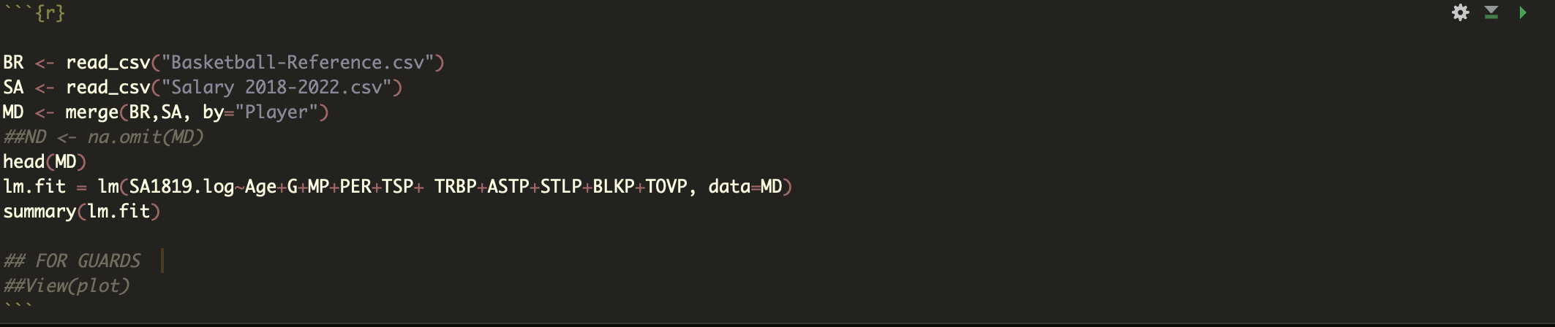
Fitter Functions for Linear Models
lm() is used to fit linear models. It can be used to carry out regression, single stratum analysis of variance and analysis of covariance
These are the the estimated coefficients we’ll be using for our multiple linear model
Notes:
http://www.sthda.com/english/wiki/correlation-test-between-two-variables-in-r#what-is-correlation-test

Slide 19
Visualization & Interpretation

Slide 20
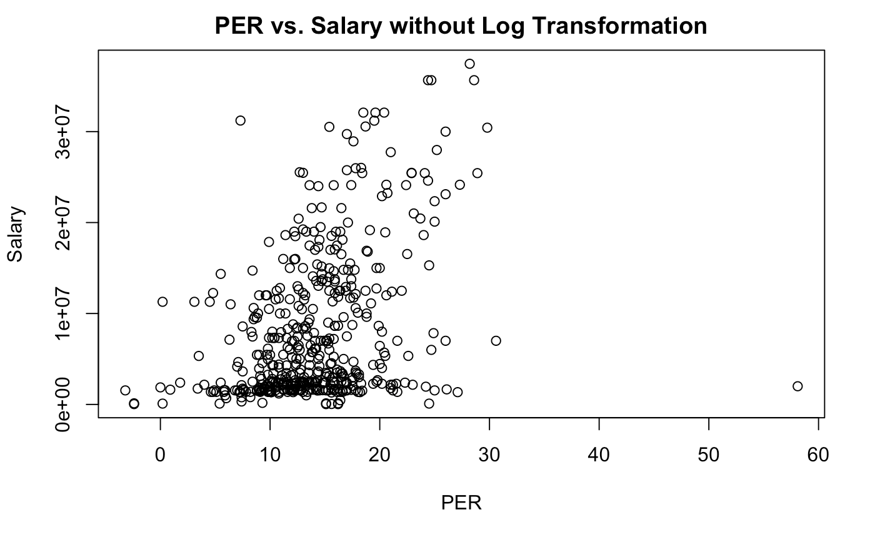
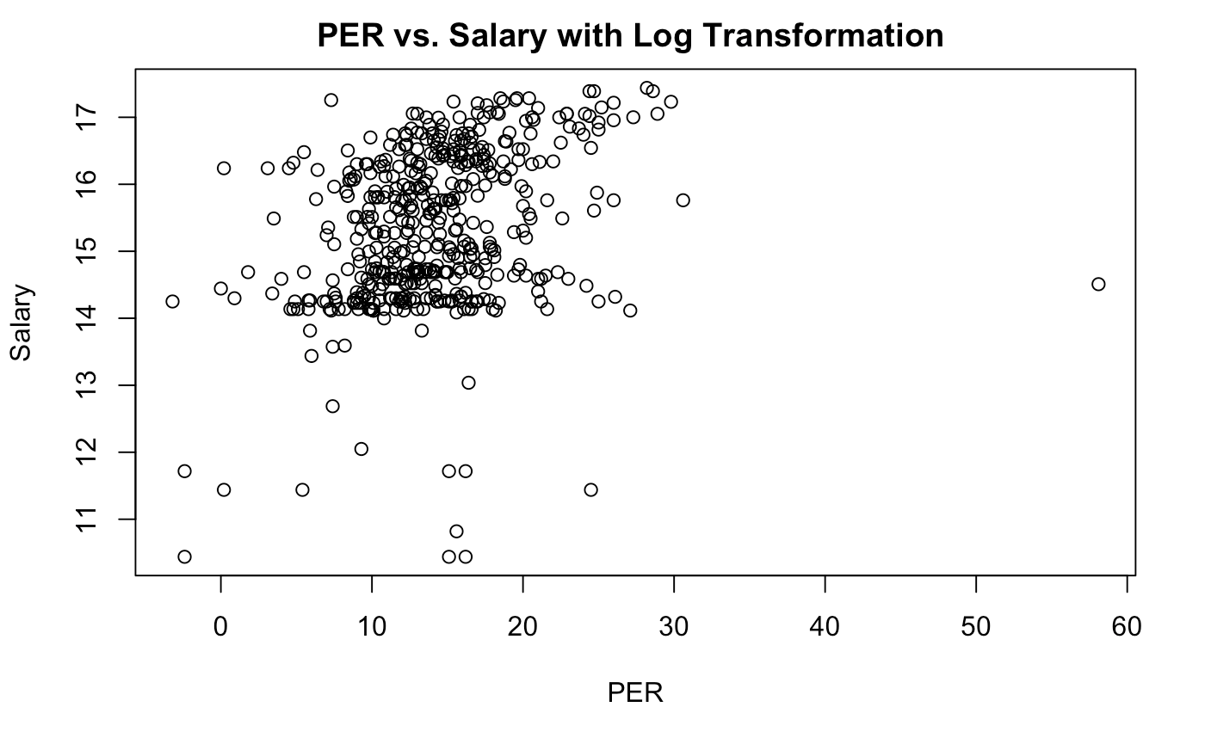

Slide 21
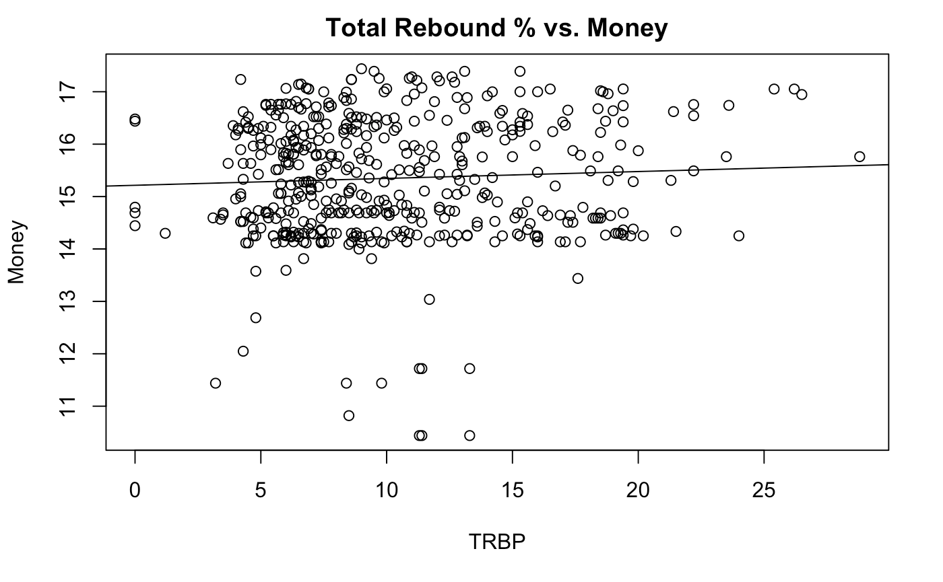
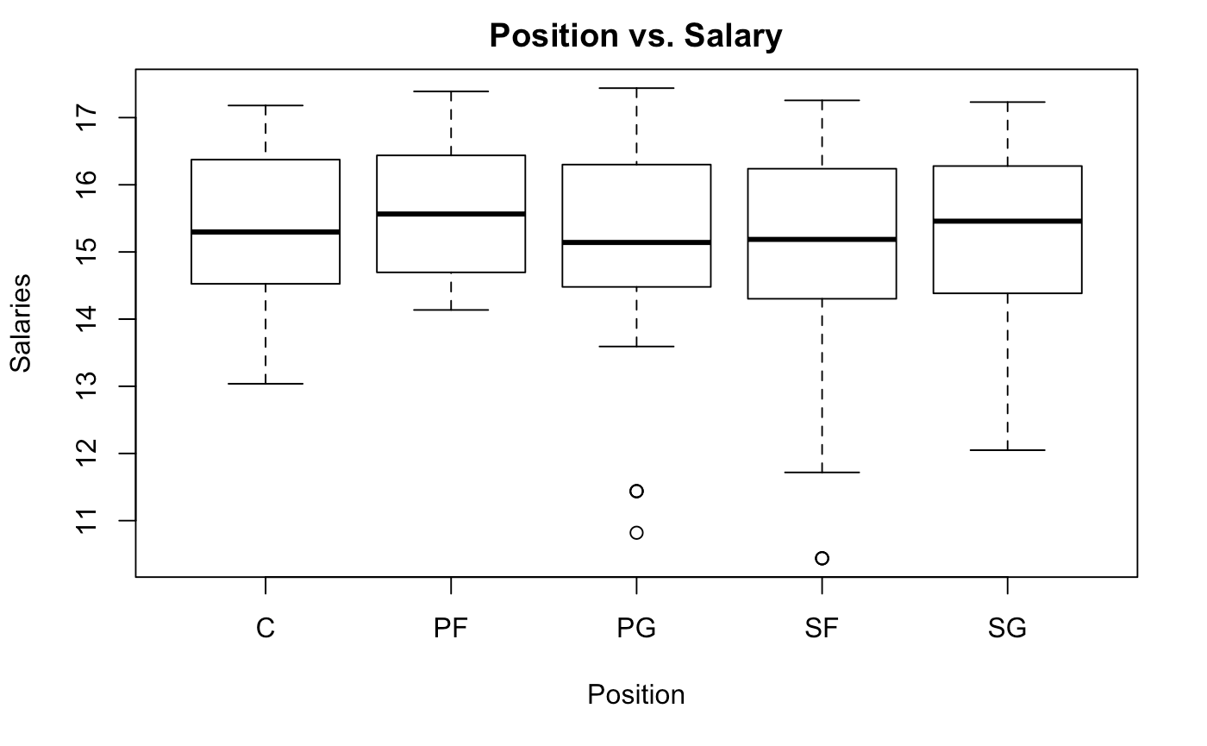
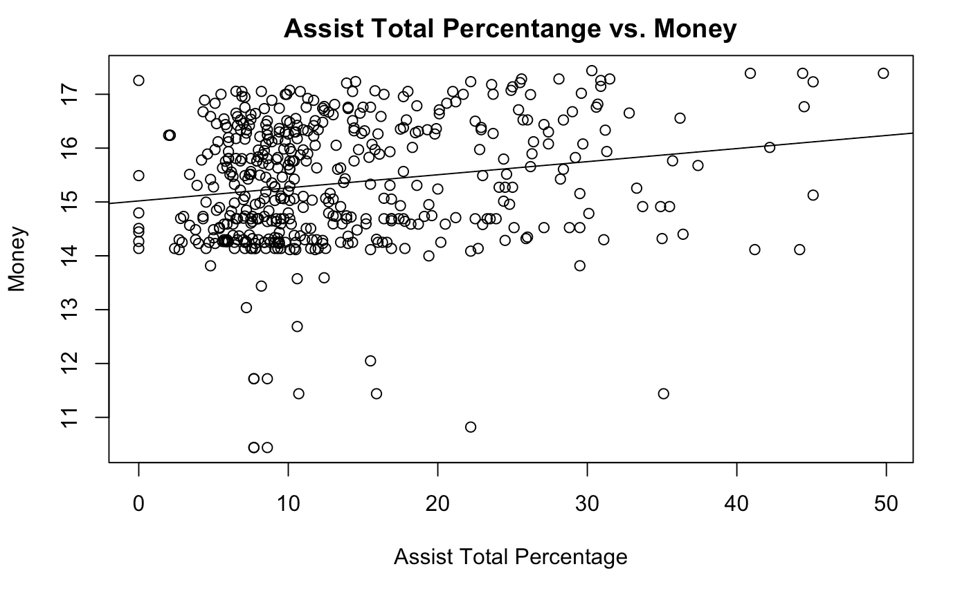

Slide 22
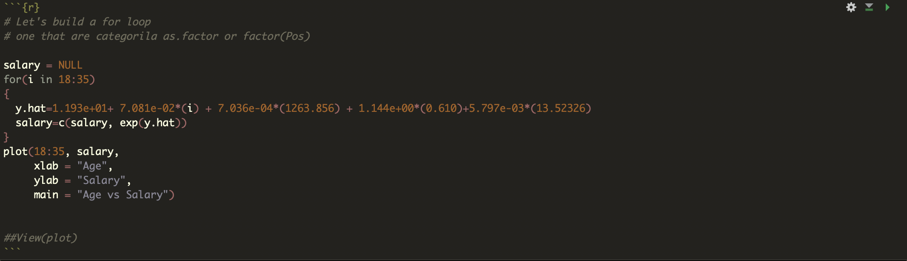
Code for Multiple Linear Regression Model

Slide 23
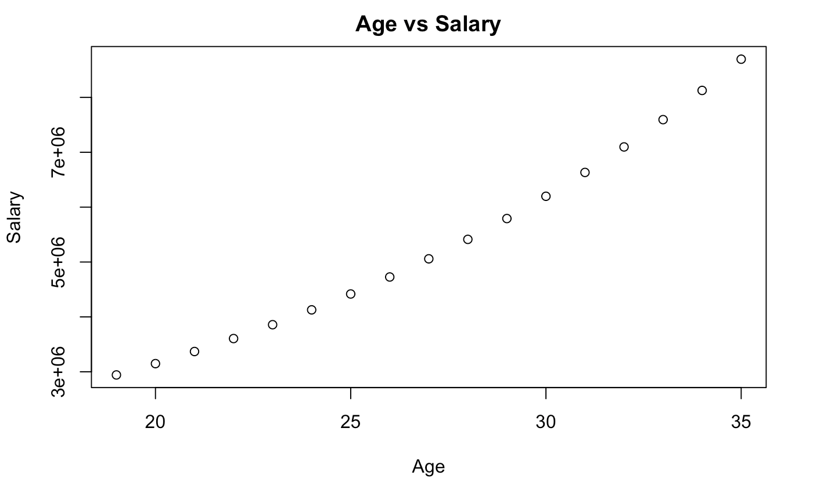
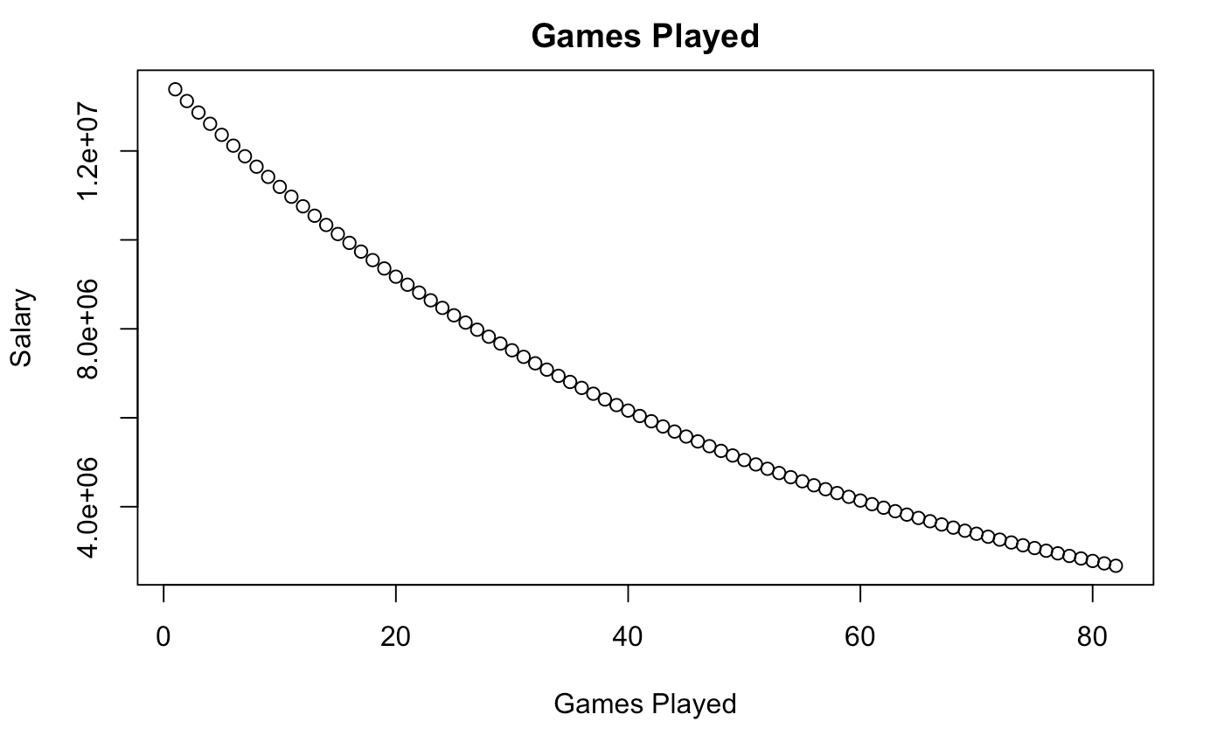
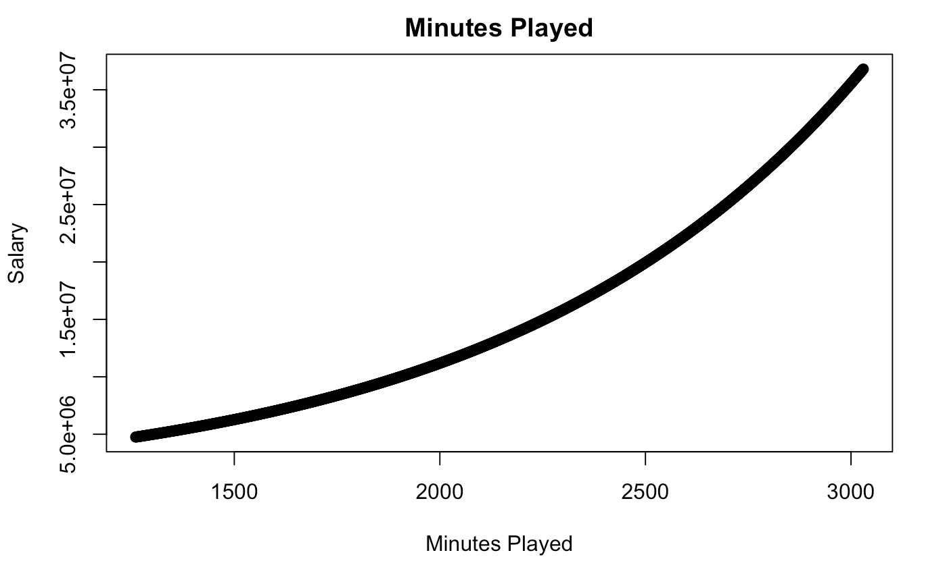
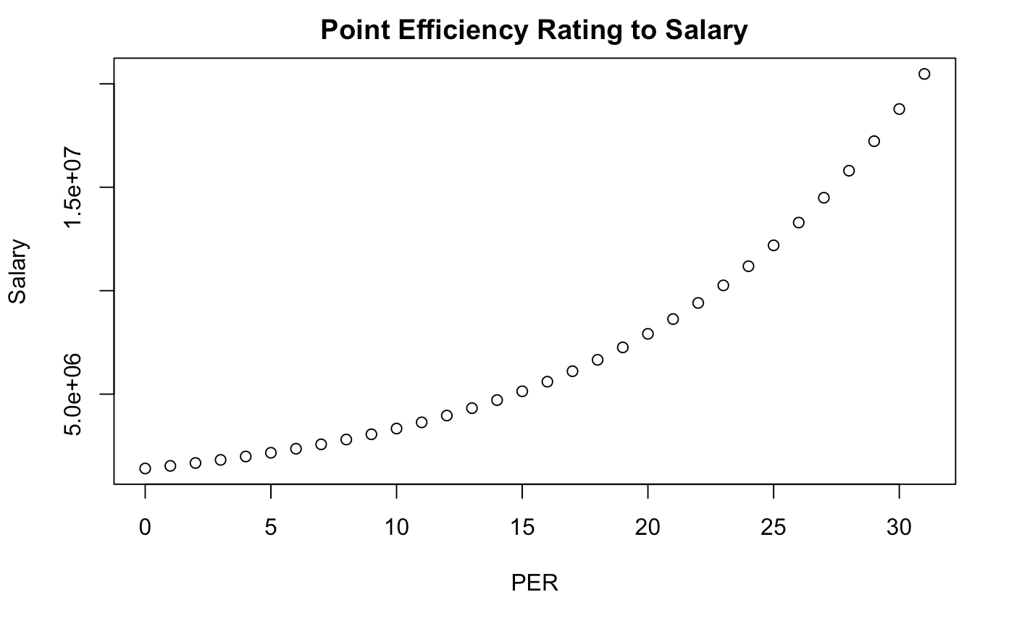
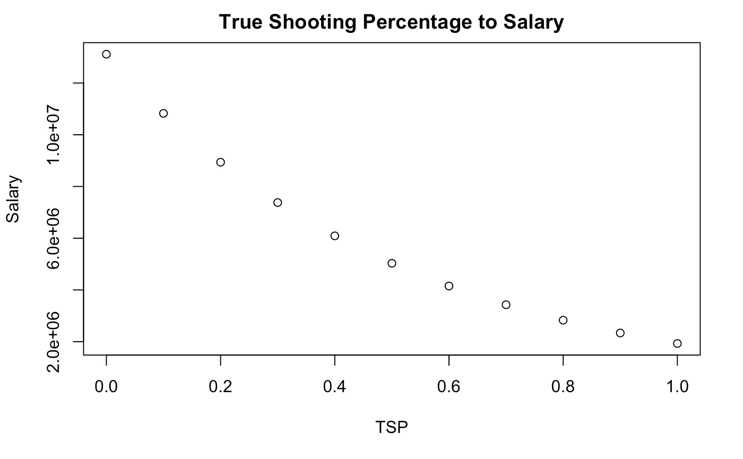
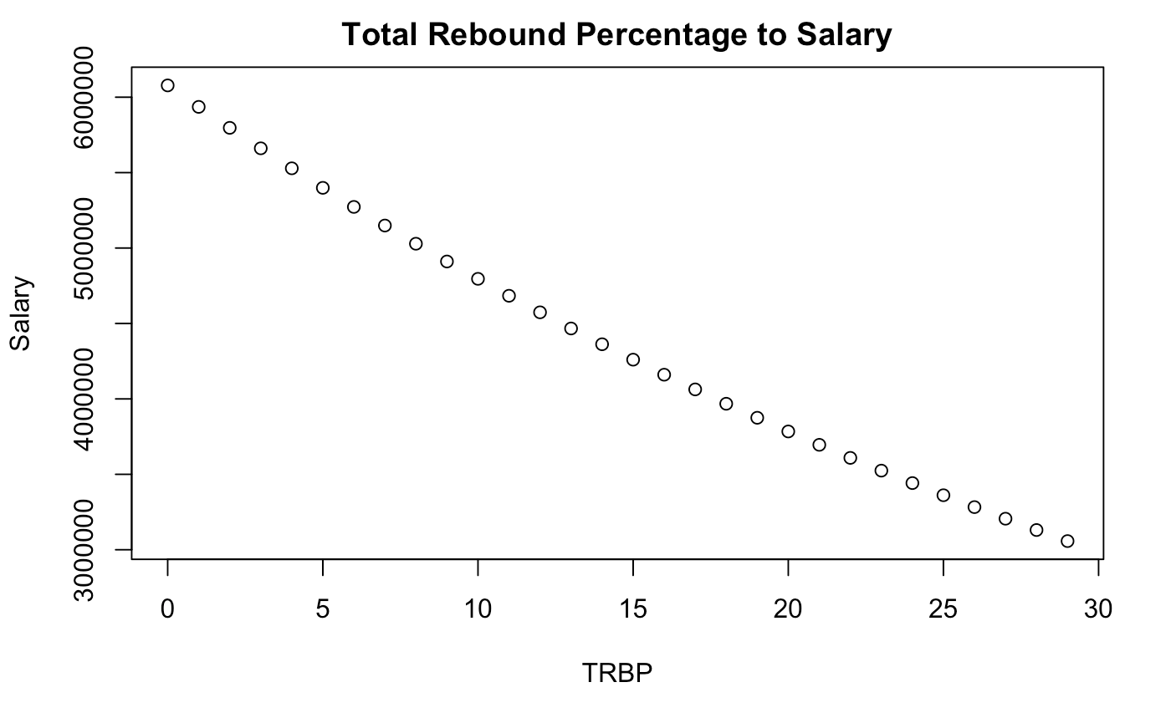

Slide 24
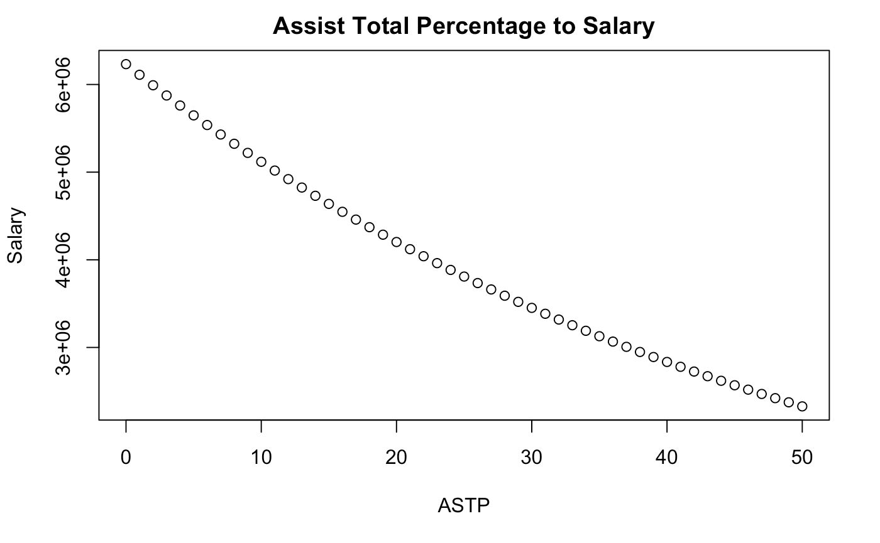
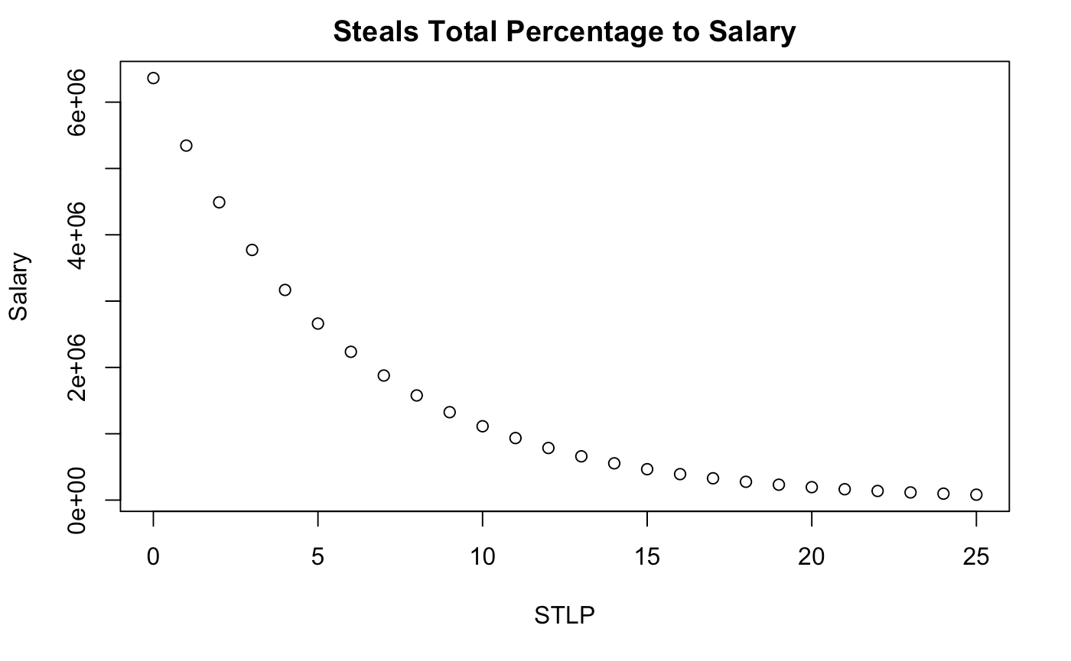
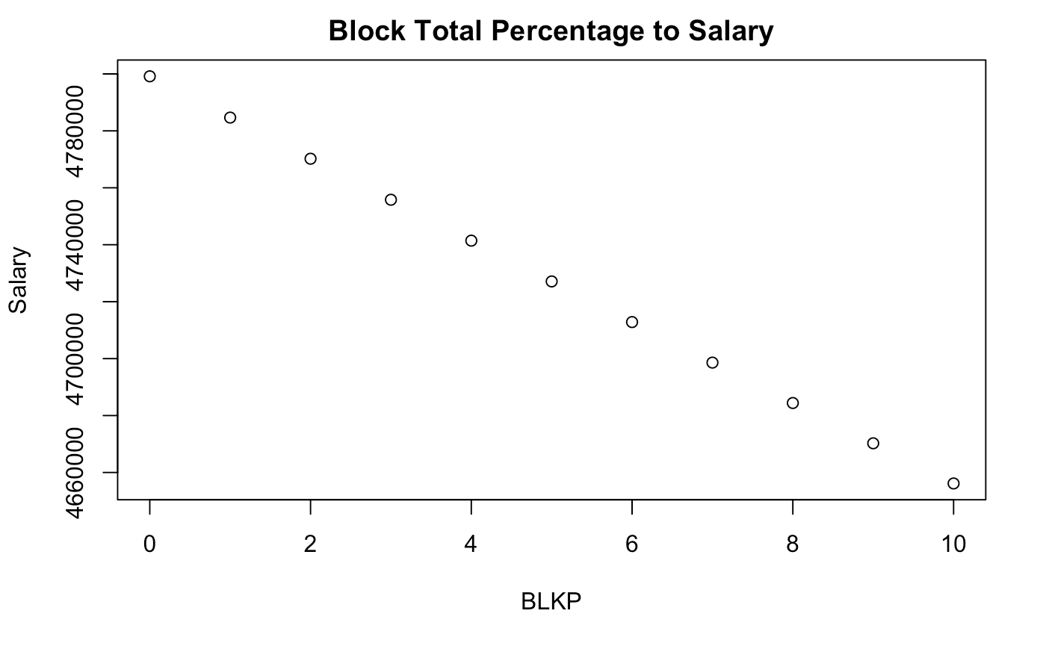
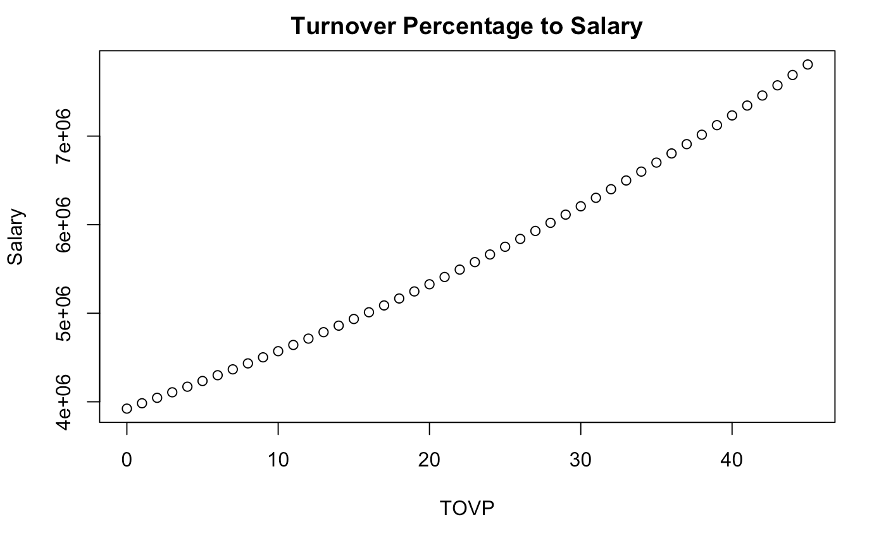

Slide 25
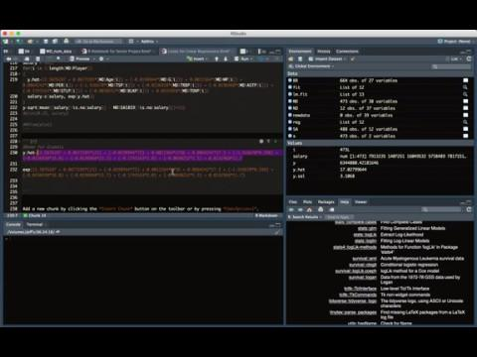

Demo Code:
Giannis Antetokounmpo
Notes:
Antetokounmpo

Slide 26
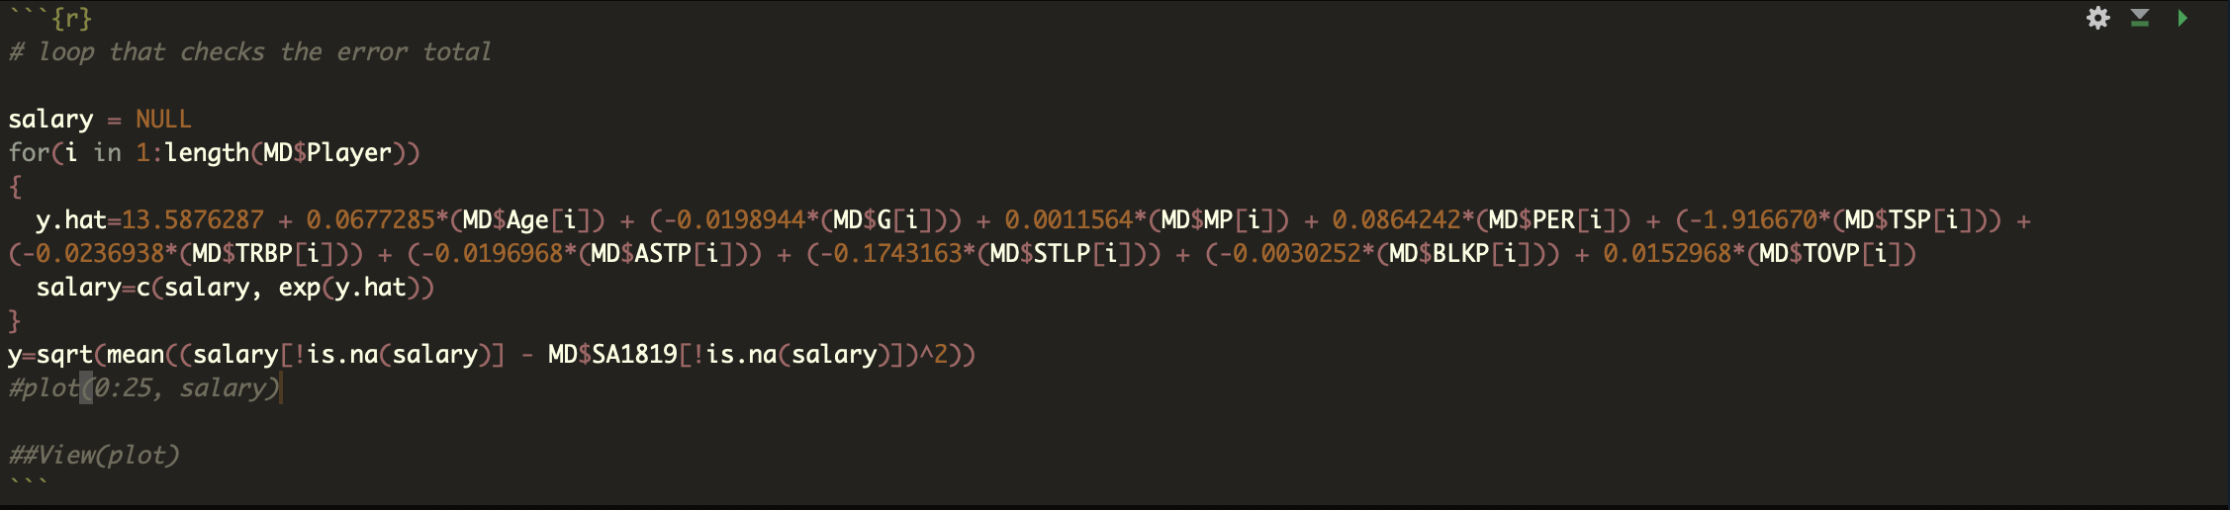

Demo for Root Square Mean Error

Slide 27
Conclusion & Takeaways

Slide 28
Questions

Slide 29
2017-18 NBA Player Stats: Advanced. (n.d.). Retrieved from https://www.basketball-reference.com/leagues/NBA_2018_advanced.html
James, G., Witten, D., Hastie, T. J., & Tibshirani, R. J. (2017). An introduction to statistical learning: With applications in R. New York: Springer.
References

Slide 30
THANK YOU!

